Slide 1
Predicting Depression Score
Based on Demographics, Income, Weight, Occupation, and Sleep
By Aiden Brown and Tony Nguyen
Notes:
Slide source: https://slidesgo.com/theme/mental-health-and-well-being-health-10th-grade#search-Mental+Health&position-2&results-441
2017-2018 Demographics Data - Continuous NHANES
2017-2018 Questionnaire Data - Continuous NHANES
Hello everyone, my name is Aiden
Welcome to our final presentation on predicting depression scores based on demographics, income, weight, occupation, and sleep
Importantly, just like we mentioned during our initial proposal, we are not psychiatry or psychology professionals, and all results are for the purpose of finding patterns to guide the course of future research, not diagnosing real people.

Slide 2
Why This Topic?
Background:
From Aug, 2021 - Aug, 2023, the CDC reported that 13.1% of U.S. adolescents and adults over the age of 12 struggle with depression, the highest prevalence was among teenagers and adolescents.
We wanted to determine if and how factors such as: • income
• sleep
• demographics
• occupation
correlate to depression diagnoses.
Notes:
Mental health is one of the most challenging epidemics facing our world today
As we mentioned in our proposal: From Aug, 2021 - Aug, 2023, the CDC reported that 13.1% of U.S. adolescents and adults over the age of 12 struggle with depression, the highest prevalence was among teenagers and adolescents
We wanted to determine if and how factors such as income, sleep, occupation, and demographics like race, gender, and level of education correlate to depression diagnosis
It should be mentioned that because NHANES is a survey, it is not a formal depression diagnosis, but it is intended to give population level estimates on the prevelance of different depression symptoms

Slide 3
Research Question
What impact, if any, do different demographics, sleep behaviors, incomes, weights, and occupations have on predicting depression score?
Notes:
Our primary research question for our project was what impact, if any, do different demographics, sleep behaviors, incomes, weights, and occupations have on depression score?
By this point you are probably wondering what depression score means. Luckily, I’m about to explain how we collected our data from the survey!

Slide 4
Data Source - CDC NHANES
The CDC has annual reports on several different health conditions
The 2017-2018 data was most accessible
NHANES - National Health and Nutrition Examination Survey
The CDC is one of the primary authorities on health in the US
Depression score is an aggregation of the severity of depression symptoms
Notes:
We sourced our data from the CDC as they produce annual reports on many different health conditions in the US
We specifically picked the 2017-2018 data because it was the most accessible data
In other words, this was the most accessible and complete data
NHANES stands for is the National Health and Nutrition Examination Survey
Additionally, we chose the CDC as our source because it is United States’ main public health organization, so their data should be credible
We should also mention that depression score is something that the CDC uses to determine population level depression prevalence, and it is an aggregation of scores from 0-3 that capture the severity of one of several depression symptoms
Although the CDC calculates depression score, they did not record it in the NHANES data set, so we had to calculate it ourselves

Slide 5
Data Cleaning and Wrangling Methods
Cleaning:
Replaced invalid values for depression indicators with NaN
Converting variables to numeric due to file conversion
Replaced encoded values with NaN
Wrangling
Merging 4 datasets by sequence number
Dropped observations with less than 6 out of 9 depression indicator questions not answered
Dropped observations that did not have a valid depression score
Notes:
Despite our dataset coming from the CDC, we had to do quite a bit of data cleaning
First, we had to replace any depression symptom indicator that was not between 0 and 3 with a NaN so the scores could only reach a max of 27 (which is the max score for depression screening in the NHANES).
We also cleaned explanatory variables by converting them to a numeric datatype because our conversion from an XPT file corrupted some of our data
We also replaced encoded values from the dataset such as arbitrary values like 98 with NaN in some of our columns like sleep and occupation
We performed an inner merge on all of the 4 raw datasets by the participants sequence number
Also, since we merged 4 large datasets we ended up having to drop a lot of columns that were not relevant to our research question
Since depression score is the aggregation of several depression indicator questions, and not every participant answered all of them, our depression scores were artificially skewed left
So, we only kept the participants who answered at least 6 out of the 9 depression screening questions
Also, we of course dropped any observations that had NaN for depression score since that was our outcome variable

Slide 6
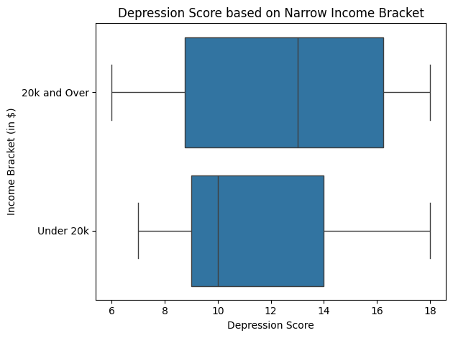
Insight from EDA: Unexpected Relationship Between Income and Depression Score
Notes:
The following boxplot shows the relationship between income bracket and the depression score
In addition to more granular separation between income categories, the surveyors encoded values for having a household income of over $20,000 and under $20,000
We both assumed that households who made more income would generally have a lower median depression score, but the opposite is the case
Those who make under $20,000 per year have a median depression score of approximately 10 while those who make over $20,000 have a median depression score of about 13.5
Additionally, the interquartile range of those who made under 20k a year is smaller than those who make over 20k, suggesting that there is greater variation of depression severity or prevalence among those with higher incomes
Although there appears to be a slight positive relationship between annual household income and depression score we should be careful about this interpretation because the income categories are quite broad
Still, this was enough for us to include a participant’s ratio to the poverty line as one of our predictor variables to explore further in our modeling

Slide 7
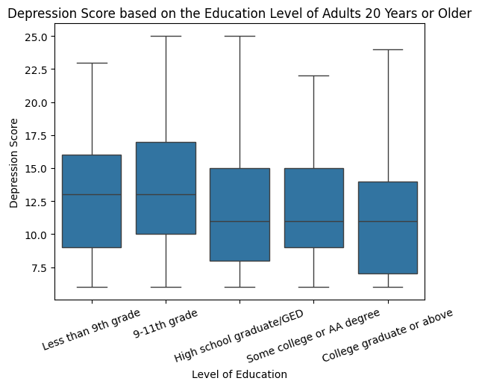
Insight from EDA: Relationship Between Level of Education and Depression Score
Notes:
Now we have another box plot demonstrating the observed relationship between level of education and depression score
It appears that those who have graduated high school (or the equivalent) or received a higher level of education have a substantially lower median depression score than those who did not reach this level of education.
Also even though the median depression score of those with less education than a high school degree is about 13, it is only about 10.5 for those who have received the equivalent of a high school education or higher
The trend appears that the more education someone has, the lower their depression score will be, suggesting a negative correlation between level of education and depression score

Slide 8
Predictive Models
Linear Regression & LASSO
Neural Network
Gradient Boosting
Setup & Features:
Trained on 5 predictors: Race, Gender, Poverty Ratio, and Weekday Sleep, and Weekend Sleep.
LASSO utilized 10-fold cross-validation.
Applied standardization to all variables.
Architecture:
Trained for 50 epochs using the same 5-feature subset.
Two linear layers with ReLU activation.
Implemented a 40% dropout rate for regularization.
Dual-Model Approach:
Regressor for continuous depression scores.
Classifier for binary target (Score >= 10).
XGBoost models used all features with one-hot encoding.

Slide 9


Results of Regression Models/Comparison
1
RMSE: 4.39
R²: -0.034
Linear Regression
Overall Interpretation:
All models yielded negative R² values, indicating they performed worse than predicting the mean. The low R² suggests that the selected predictors (Race, Gender, Poverty Ratio, Sleep) may not meaningfully capture the correlation to depression scores in this dataset.
The Gradient Boosting model showed a slight improvement in R² compared to other models, suggesting a potential for other variables to be explored further.
2
RMSE: 4.39
R²: -0.034
LASSO
3
RMSE: 4.6
R²: -0.15
Neural Network
4
RMSE: 4.48
R²: -0.022
Gradient Boosting

Slide 10
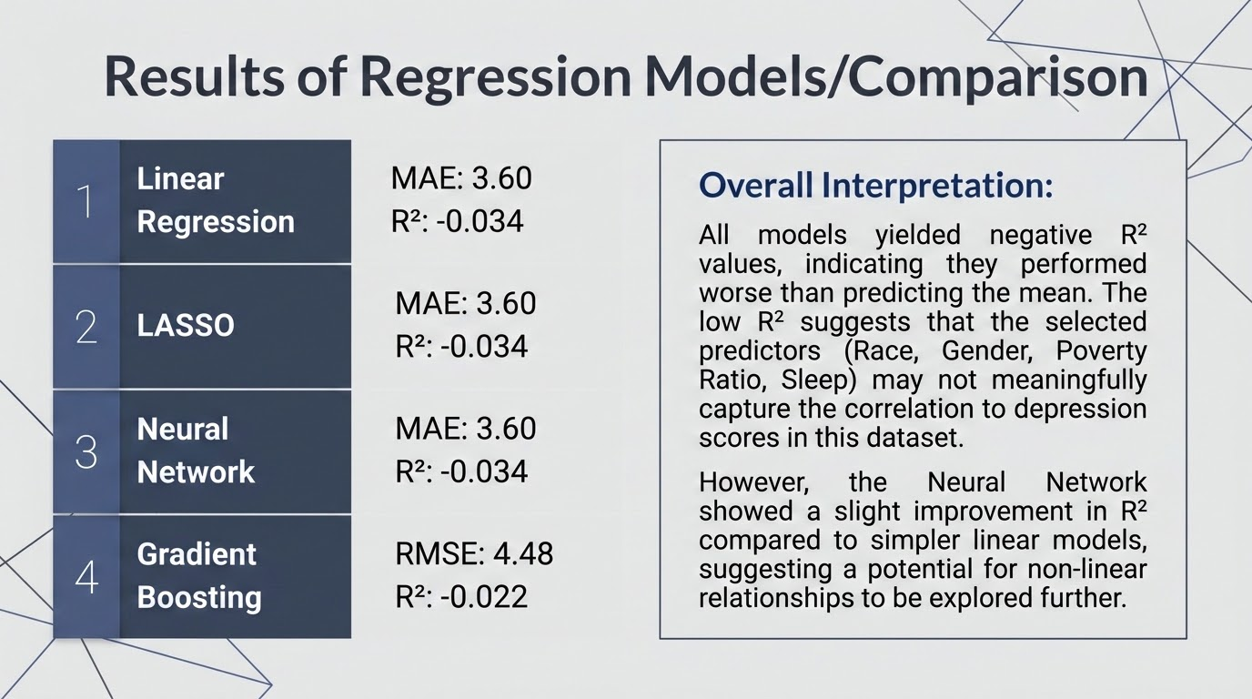

Slide 11
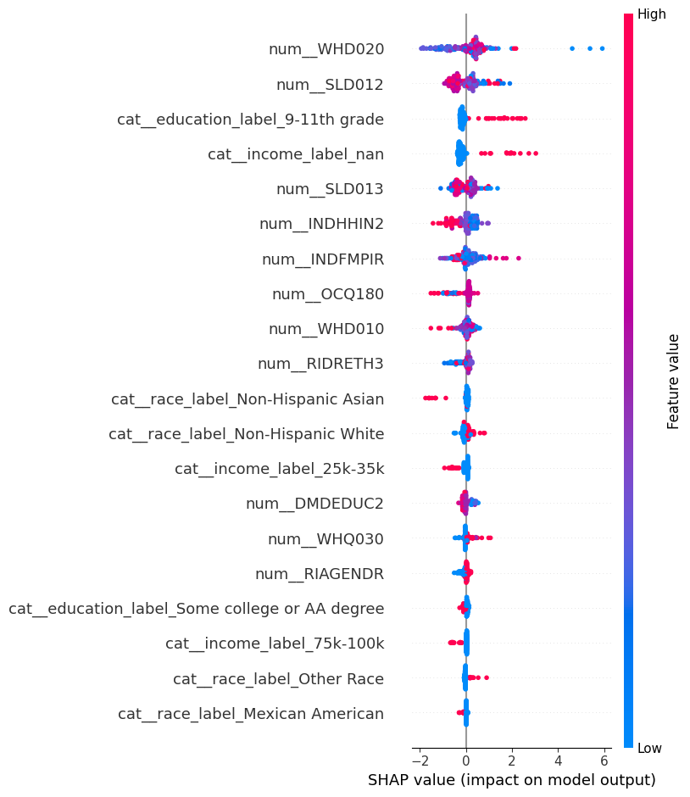
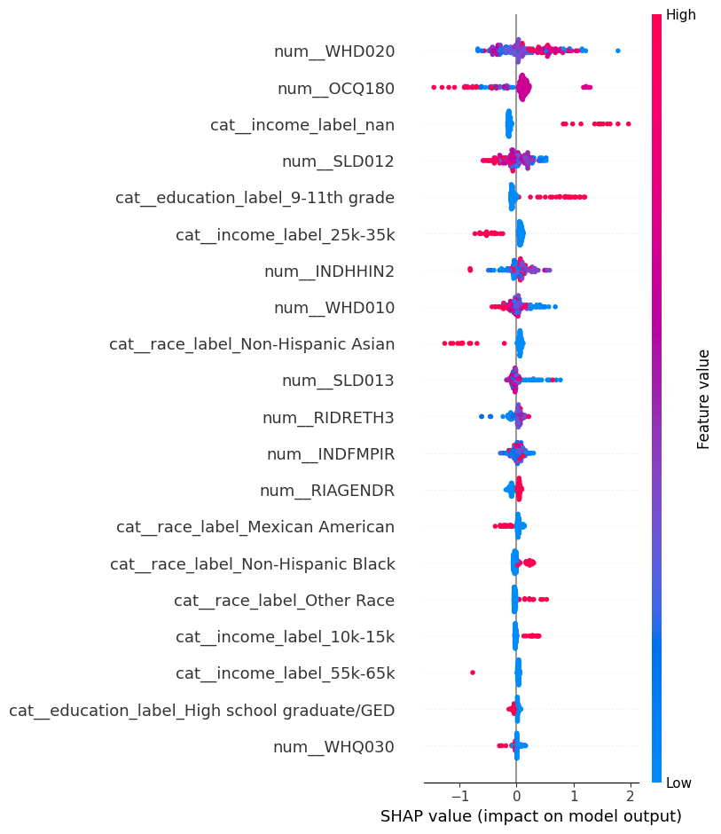
SHAP Value Analysis
Feature Impact on Regression vs. Classification Models
Regression Model
Classification Model (Depression > 10)

Slide 12
Limitations
1. Only used Data from US 2017-2018
2. We selected predictor variables based on our hypotheses
3. Depression Score is not Depression Diagnosis
4. Data we (necessarily) dropped may have changed relationships
Notes:
One of the biggest limitations is that we only used data collected during one year, and only for participants in the United States, meaning we cannot generalize our conclusions
Additionally, given the scope of the project, we had to select a subset of the recorded data, meaning we could have potentially ignored other predictor variables that demonstrated a clearer correlation to depression score
Also, depression score is not intended to act as a depression diagnosis, and instead it is supposed to help understand population wide trends regarding the prevalence of depression, not to assess individuals
This means that correlation between our predictors and depression score does not equate to correlation between our predictors and a depression diagnosis or severity of depression
Lastly, we did have to drop a substantial proportion of our data in order to get reasonable depression scores and avoid NaN values for our predictor variables
As a result the strength of the relationships between different predictors and depression may have been slightly altered due to a smaller dataset (however we had good reasons for dropping these observations)

Slide 13
Conclusions and Future Work
Conclusions
EDA suggested possible correlations between predictors and depression score but our models had weak performance
Our predictor variables were not strong enough on their own to predict depression score
task_alt
Future Work
How will our models perform with data from other years and other nations?
Increase quantity and variety of predictor variables
Compare depression score and another metric of depression? Are the same predictors relevant?
update
Notes:
As for our conclusions, our predictor variables did not strongly predict depression score.
Although the results of our EDA suggested possible relationships between income, education, and depression score, our models performed worse on average than guessing the mean depression score
Therefore, our models demonstrated that our predictors are not strong enough to conclude that there is a strong relationship between our selected predictor variables and depression score
We aren’t claiming that our predictor variables have no impact on depression score, but our models show they aren’t influential enough on their own to predict it
The main focus of any future work would be to see how our models (especially the neural network) perform when used on data outside of 2017-2018, and outside of the US
Additionally, we would increase our subset of predictor variables to see if there are any stronger correlations between other demographics we missed, or even other health conditions and depression score
Lastly, we would want to find another metric of calculating severity of depression across the population other than the NHANES’ metrics and see if the same predictor variables are correlated with depression score.

Slide 14
Thanks!
What questions do you have?

